Slide 1
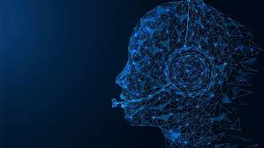
Virtual Personal Assistant Using AI
Team Members:
Gokula Krishnan. S
Hariharan. M
Rithika. S

Slide 2
ABSTRACT
In this project, we embark on the development of a sophisticated Virtual Personal Assistant (VPA) utilizing the combined capabilities of Artificial Intelligence (AI) and the Internet of Things (IoT). Our VPA boasts a remarkable ability to comprehend natural languages and diverse accents, enabling seamless interaction with users through voice commands. It serves as a central hub for managing various household tasks, effortlessly integrating with a wide array of home devices commonly found in modern households. From controlling smart appliances to setting reminders and managing schedules, users can rely on the VPA to streamline their daily routines with ease and efficiency.
One of the key objectives of our project is to prioritize accessibility and affordability, ensuring that the benefits of this advanced technology are available to all segments of society. By offering a user-friendly interface and minimizing hardware requirements, we aim to make the VPA accessible to a broad audience, regardless of their technical expertise or financial resources. Through this project, we aim to demonstrate the transformative potential of AI and IoT technologies in enhancing daily life experiences.

Slide 3
EXISTING SYSTEM
Additionally, the system's lack of customization options means that users may not be able to tailor the VPA's responses and behaviors to their specific preferences and needs, resulting in a less personalized experience.
The existing system its understanding of complex requests can be limited, leading to frustration when users' commands are misunderstood or misinterpreted.
Furthermore, the setup of the system can be costly, requiring users to invest in specific hardware and software, which may deter those with limited financial resources from utilizing it.
Lastly, the system's reliance on an internet connection for full operation poses challenges, especially in areas with constrained internet access or during network outages, limiting its accessibility and usability.
Despite these drawbacks, the existing system represents a significant advancement in AI and IoT integration, showcasing the potential for technology to enhance daily life experiences

Slide 4
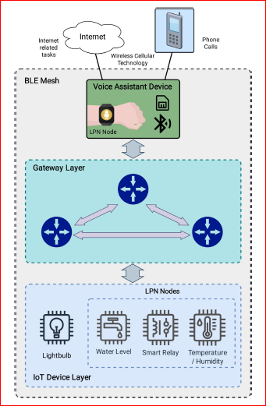
EXISTING SYSTEM BLOCK DIAGRAM

Slide 5
DRAWBACKS OF EXISTING SYSTEM
Limited Understanding: Sometimes virtual assistants struggle to understand complex requests, which can be frustrating for users when they don't get what they need.
Lack of Customization: Users often can't change how their virtual assistant responds or acts, so it might not fit their preferences very well.
Costly Setup: Creating a virtual assistant can be pricey due to the need for specific tools and software, potentially excluding those with limited financial resources from utilizing it.
Accents and Dialects: Some virtual assistants have trouble understanding different ways people talk, like accents or regional dialects. This can cause mistakes and confusion when they try to respond

Slide 6
PROPOSED SYSTEM
The proposed system aims to address the limitations of existing virtual personal assistant systems. By leveraging advanced natural language understanding algorithms, the system strives to enhance comprehension of complex requests, reducing user frustration.
Customization options will be expanded to empower users to tailor the VPA's responses and behaviors to their unique preferences and needs, thereby enhancing personalization.
Moreover, the system will focus on affordability by optimizing hardware and software requirements, making it accessible to a wider range of users.
Through these enhancements, the proposed system seeks to overcome the challenges of current VPAs, providing a more intuitive, personalized, and accessible user experience while maintaining the convenience and efficiency of AI and IoT integration

Slide 7
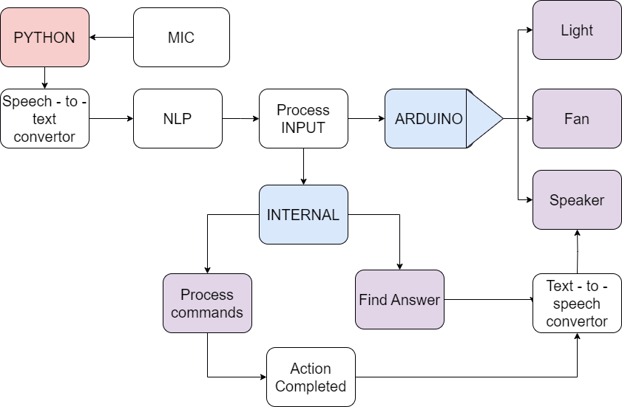
PROPOSED SYSTEM BLOCK DIAGRAM

Slide 8
ADVANTAGES OF PROPOSED SYSTEM
Improved Natural Language Processing: Invest in advanced techniques, such as natural language processing to enhance the assistant's ability to understand and interpret user requests accurately.
Privacy Keyword: It have a keyword called JARVIS to activate the virtual assistant in your desktop when it is in sleep.
Customization Options: Offers users the ability to personalize their assistant by their own preference ,we can also change the keyword.
Understanding Accents : It understands the multiple user accents and understoods the commands by the help of keyword and produce the actions.
Human-like Interaction: Incorporate natural language generation (NLG) techniques, Design responses to be more expressive, empathetic, and engaging to enhance the user experience

Slide 9
SOFTWARE REQUIREMENTS
Python Modules
Speech Recognition Library : Enables the conversion of speech to text
gTTS (Google Text-to-Speech) Module : Synthesizing text into speech for natural-language responses.
Google Search API : Accesses web search.
Webbrowser : Use to access the web browser programmatically.
PyAudio Module : Essential for audio input and output functionalities.
Nltk Library : Used to process the natural language..
Pygetwindow : A module for interacting with windows and obtaining information about them.
Os : A module providing a portable way of using operating system-dependent functionality.
Pydub : A high-level audio processing library for Python.

Slide 10
COMPONENTS USED
Intel Core i5 or similar.
8 GB RAM
10 GB Free Disk Space
Speaker
Mic
Communication Networks (Wi-Fi)
LED lights
Fan
Microcontrollers or IoT Devices

Slide 11
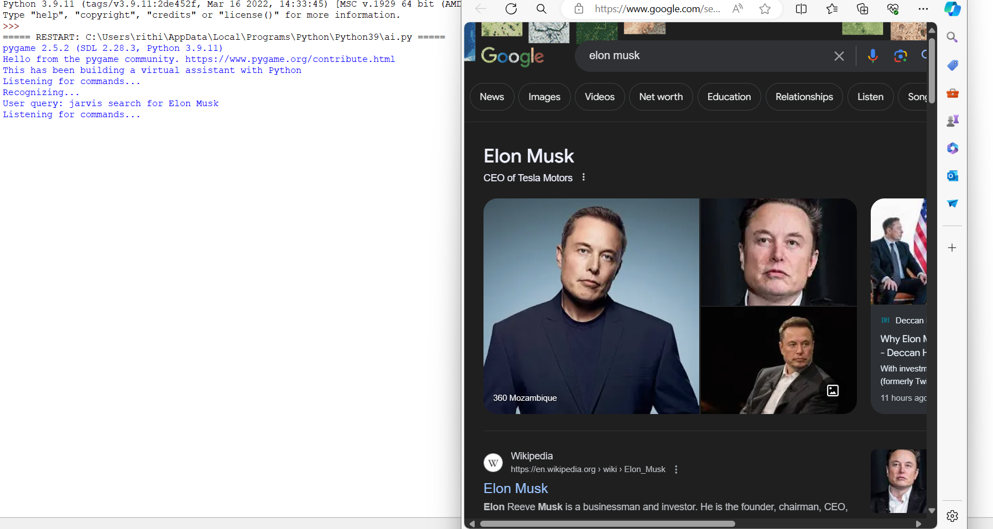
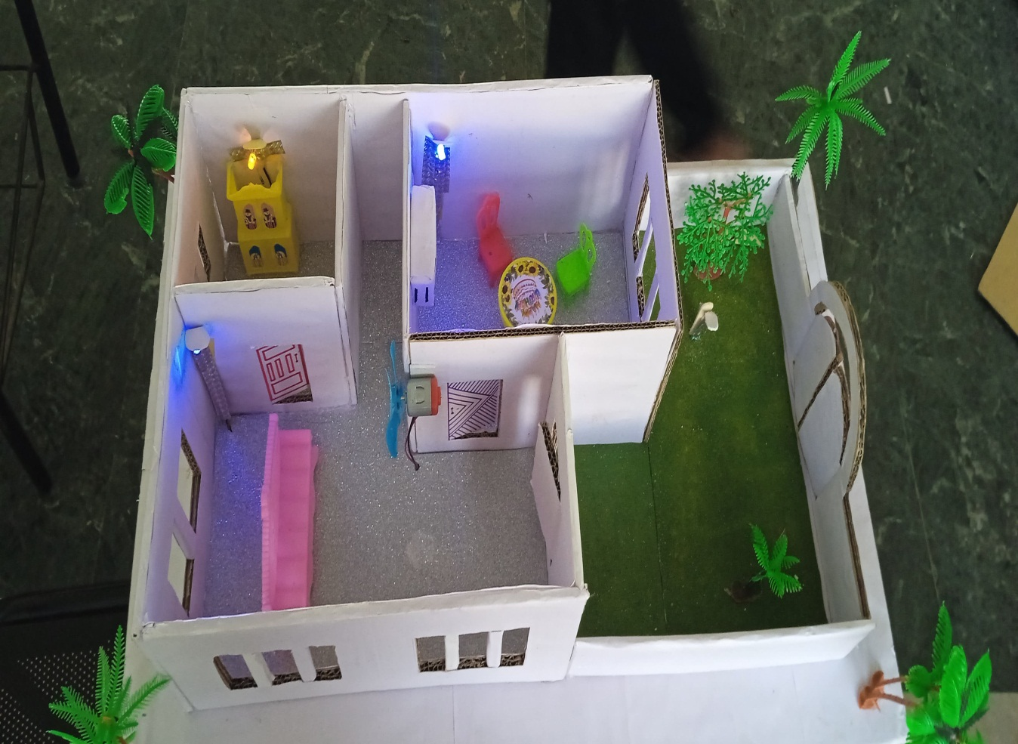
SNAPSHOTS

Slide 12
REFERENCES
P. Kaur, P. Singh, and V. Garg,‘‘Speech recognition system; challenges and techniques,’’ Int. J. Comput. Sci. Inf. Technol., vol. 3, no. 3, pp. 3989–3992 , 2020.
E. Guglielmi, G. Rosa, S. Scalabrino, G. Bavota, and R. Oliveto, ‘‘Sorry,I don’t understand: Improving voice user interface testing,’’ in Proc. 37th IEEE/ACM Int. Conf. Automated Softw. Eng., Oct. 2022, pp. 1–12.
J. Lau, B. Zimmerman, and F. Schaub, ‘‘Alexa, are you listening?’’ Proc.ACM Hum.-Comput. Interact., vol. 2, pp. 1–31, Nov. 2018
W.-N. Hsu, B. Bolte, Y.-H. H. Tsai, K. Lakhotia, R. Salakhutdinov, and A. Mohamed, ‘‘HuBERT: Self-supervised speech representation learning by masked prediction of hidden units,’’ IEEE 3451–3460, 2021.
A. Radford, J. Wook Kim, T. Xu, G. Brockman, C. McLeavey, and I. Sutskever, ‘‘Robust speech recognition via large-scale weak supervision,’’2022, arXiv:2212.04356.
T. Sipola, J. Alatalo, T. Kokkonen, and M. Rantonen, ‘‘Artificial intelligence in the IoT era: A review of edge AI hardware and software,’’ in Proc.31st Conf. Open Innov. Assoc. (FRUCT), Apr. 2022, pp. 320–331.

Slide 13
A. Ghosh, D. Chakraborty, and A. Law, ‘‘Artificial intelligence in Internet of Things,’’ CAAI Trans. Intell. Technol., vol. 3, no. 4, pp. 208,218,Dec. 2018.
A. Pradhan, A. Lazar, and L. Findlater, ‘‘Use of intelligent voice assistants by older adults with lowtechnologyuse,’’ACMTrans. Comput.-Hum. Interact., vol. 27, no. 4, pp. 1–27, Aug. 2020.
S. Ashwini, N. R. Rajalakshmi, P. V. Paul, and L. Jayakumar, ‘‘Dynamic NLP enabled chatbot for rural health care in India,’’ in Proc. 2nd Int. Conf.Comput. Sci., Eng. Appl. (ICCSEA), Sep. 2022.
Y.-C. Zhou, Z. Zheng, J.-R. Lin, and X.-Z.‘‘Integrating NLP and context-free grammar for complex rule interpretation towards automated compliance checking,’’ Comput. Ind., vol. 142.
S. Sen, J. Koo, and S. Bagchi, ‘‘TRIFECTA: Security, energy efficiency,and communication capacity comparison for wireless IoT devices,’’ IEEE Internet Comput., vol. 22, no. 1, pp. 74–81, Jan.2018.
R. Errattahi, A. El Hannani, and H. Ouahmane, ‘‘Automatic speech recognitionerrors detection and correction: A review,’’ Proc. Comput. Sci.,vol. 128, pp. 32–37, Jan. 2018.

Slide 14


